Slide 1

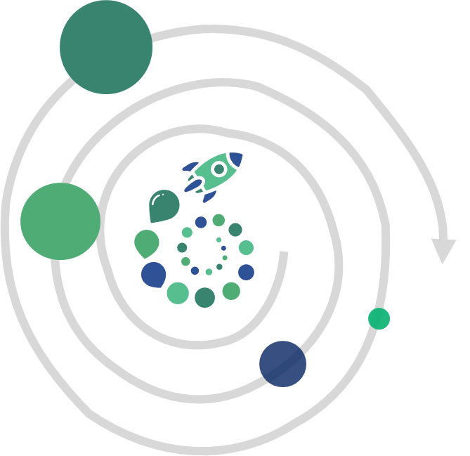













NEW ROLES
Architecture
Community
Enterprise & portfolio
PATTERNS
data
STYLES
Experts
sustainable and systemic approach
SECU
Market
End user
enterprise
ARCHITECT
in
Platforms
PRODUCT
ARCHITECT
Full stack
ARCHITECT
NEW RITUALS
« END TO END »
« FULL STACK »
NEW PRACTICES
DELIVERY
TEAMS
VISION
INTENTIONAL
Scoping
360°
Run
LEARNINGS
DOMAIN
DRIVEN
DESIGN
Kit
ORGANISATION
EMERGENT
SYSTEMIC
Notes:
ROLE
Need a systemic approach to build resilient distributed systems (full-stack) and that provides an great user experience (end-to-end processes, usage)
RITUALS
MVP SCOPING 360°
BOOSTER FEEDBACKS
PRACTICES
DDD TO REDUCE AND MANAGE TEAM DEPENDANCIES
KEY MESSAGES
SYSTEMIC
SCOPING 360°
DEPENDANCIES

